Slide 1

DEPARTMENT OF COMPUTER SCIENCE AND ENGINEERING
SMART LAB ANALYZER
PRESENTED BY,
GUIDED BY,
MURUGAVEL V – 714023104074 III CSE - B SIET
Mrs. SHARMILA Assistant Professor - CSE SIET

Slide 2
AGENDA
ABSTRACT
INTRODUCTION
EXISTING SYSTEM
PROPOSED SYSTEM
SOFTWARE REQIRMENTS
UML DIAGRAMS
OUTPUT SCREENSHOT
DEMO VEDIO
CONCLUSION

Slide 3
ABSTRACT
The app helps teachers manage students, labs, and performance in one place.
Attendance, marks, and progress can be tracked quickly and clearly.
The system reduces manual work, saves time, and improves student performance.

Slide 4
INTRODUCTION
The app helps teachers manage students, labs, and academic records in one place.
Teachers can mark attendance, record marks, and track performance with ease.
Improves efficiency, saves time, and supports better student learning outcomes.

Slide 5
EXISTING SYSTEM
Teachers depend on manual registers or spreadsheets, which are time-consuming and error-prone.
Performance tracking is limited to marks only, with no clear insights or trends.
Reports are prepared manually, leading to delays and extra workload.
No centralized system for attendance, marks, and student records in one place.
No proper digital system for storing and accessing lab performance easily.

Slide 6
PROPOSED SYSTEM
The app provides a single digital platform for managing students and lab activities.
Teachers can mark attendance, record marks, and track performance quickly in one place.
The system uses clear dashboards and color codes to easily identify student progress.
Reports can be generated instantly and shared with students or management without delay.
Students records are stored safely and can be accessed anytime, ensuring accuracy and efficiency.

Slide 7
SOFTWARE REQUIREMENTS
Operating System Android 8.0
Front-End Technology Flutter (Dart)
Back-End Technology Node.js with Express.js
Database Firebase
Development Tools VS Code (Coding),
Android Studio (Testing),
Expo CLI (Deployment).

Slide 8
FLOWCHART

Slide 9
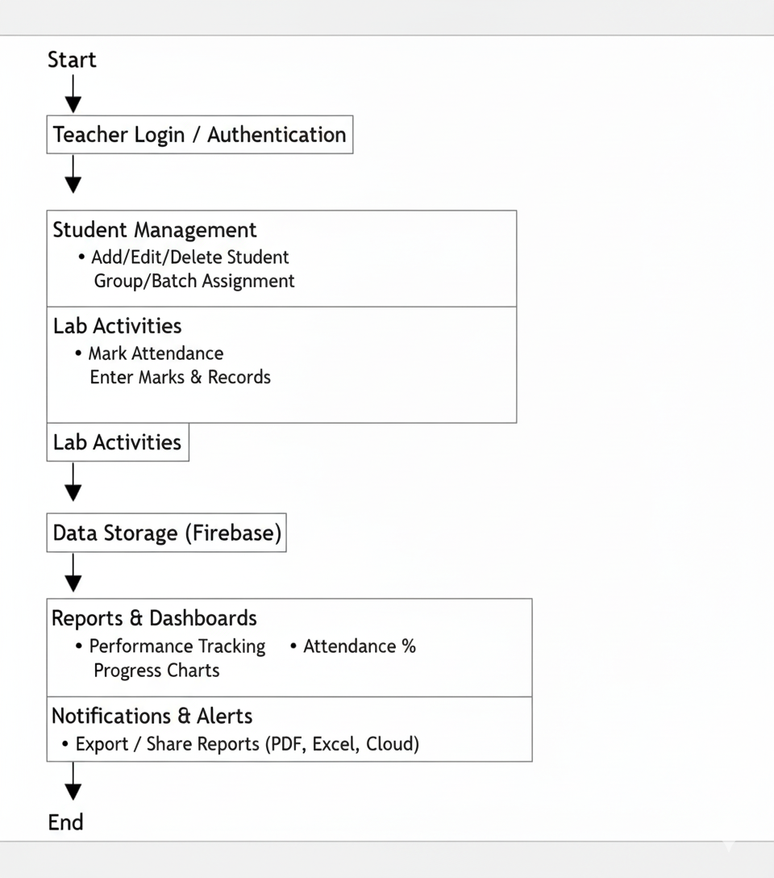
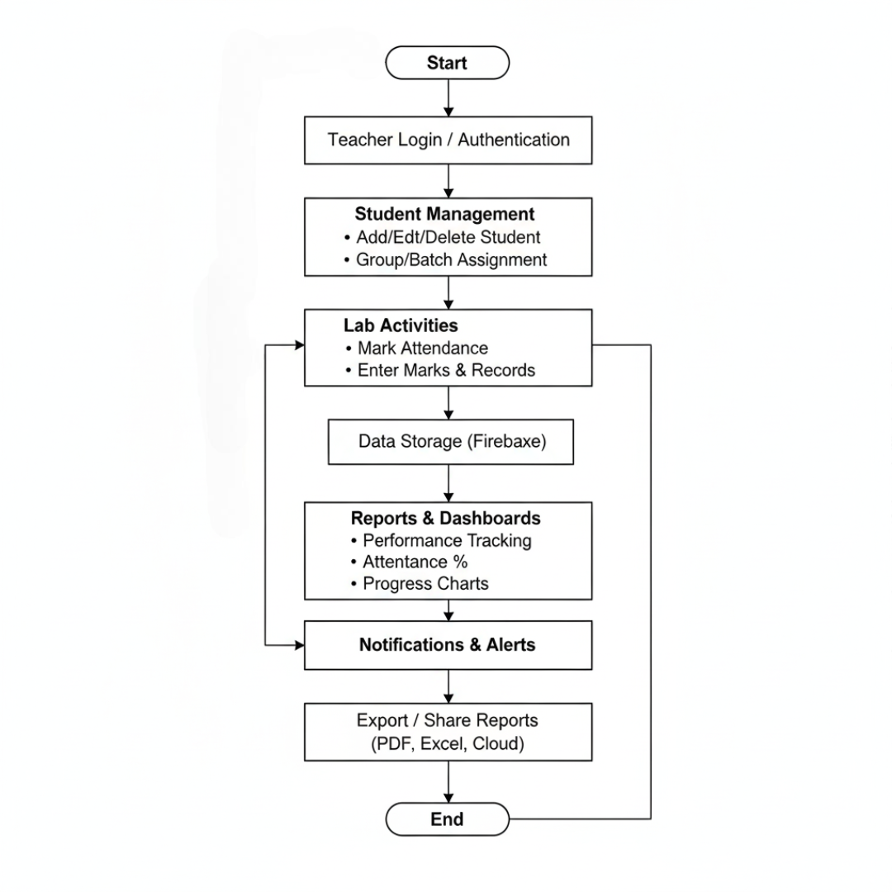
USE CASE DIAGRAM

Slide 10
REAL WORLD EXAMPLE
Scenario: Teacher wants to manage a lab class.
How it works:
Teacher opens the app and logs in.
Selects the batch and subject.
Marks attendance for students.
Enters lab marks and notes for each student.
The app stores all data safely in one place.
Reports and progress charts are generated instantly.
Outcome: Saves teacher’s time,
reduces manual errors, and helps both teachers and students track performance easily.

Slide 11
OUTPUT SCREENSHOTS

Slide 12
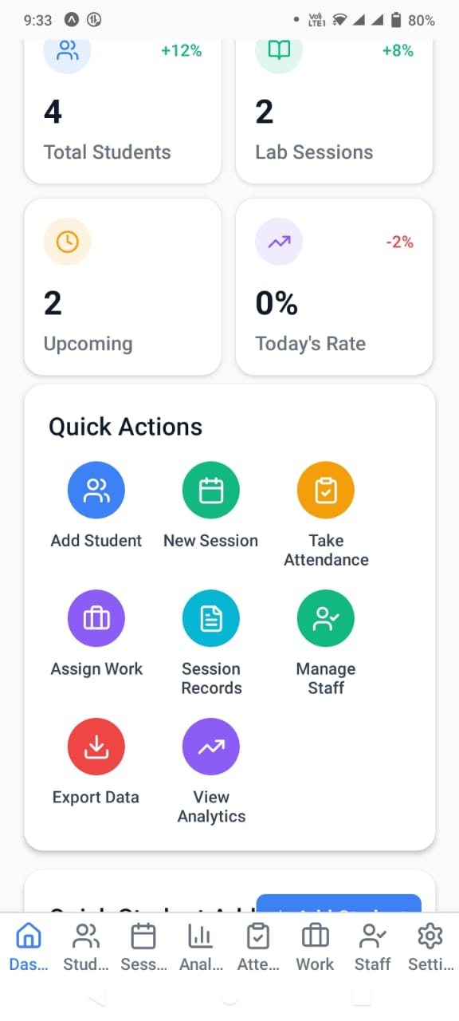
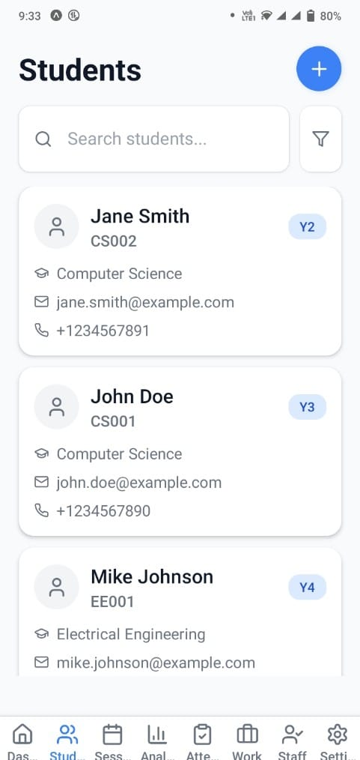
1. Dashboard 2. Students

Slide 13
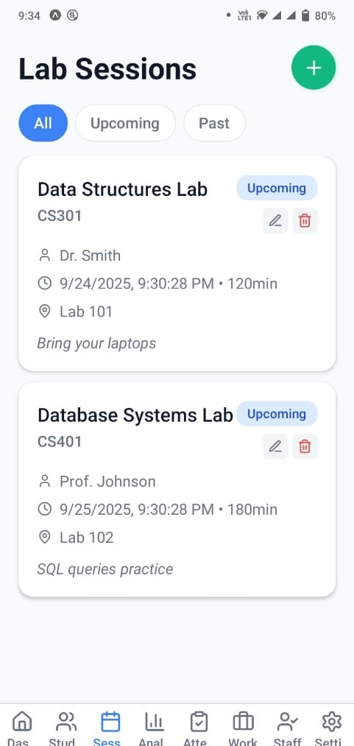
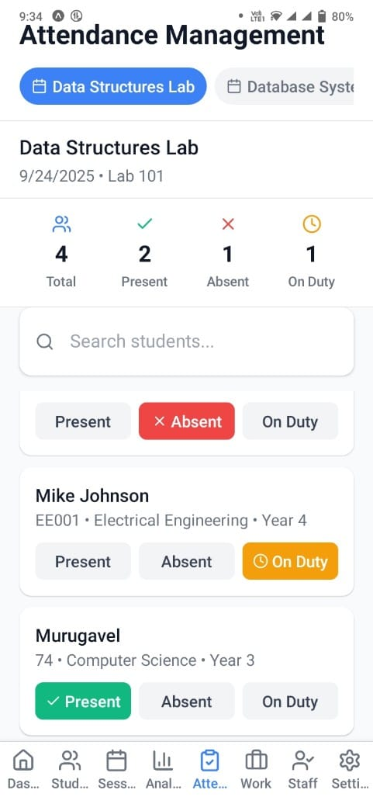
3. Lab Sessions 4. Attendance Management

Slide 14
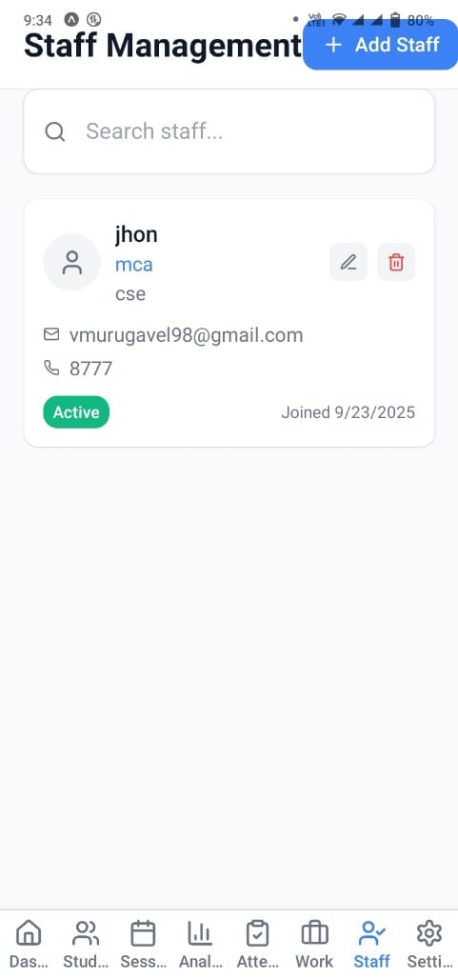
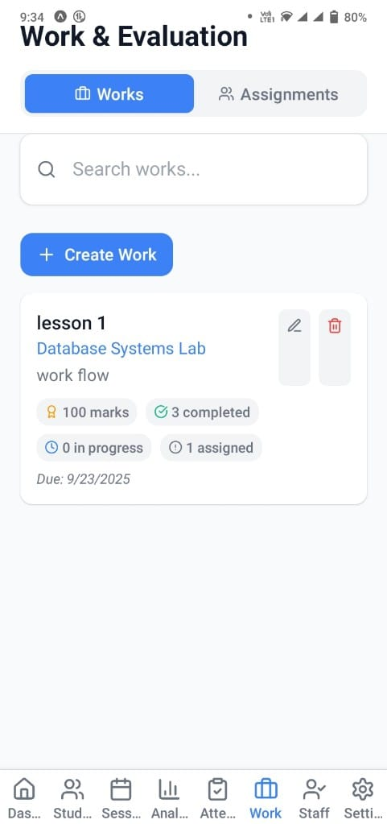
5. Staff Management 6. Work & Evaluation

Slide 15
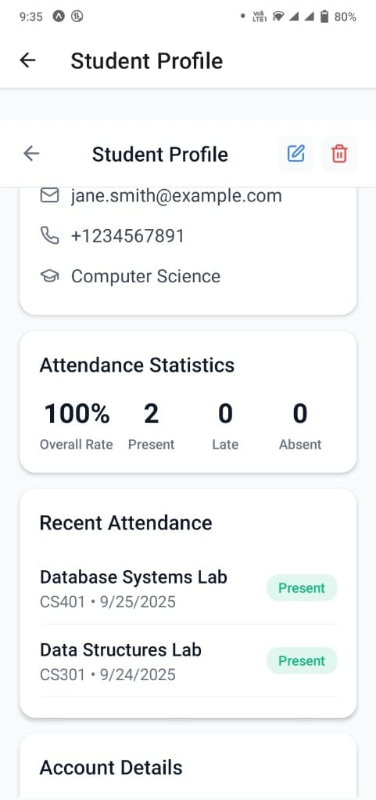
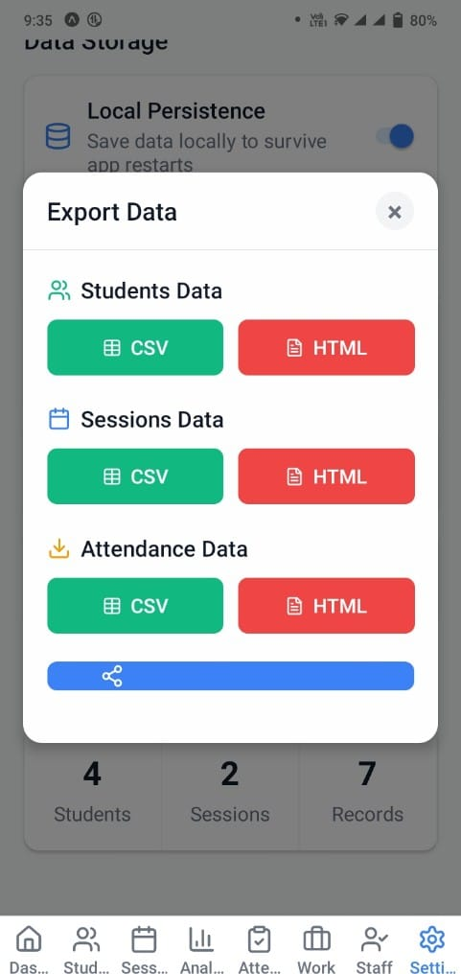
7.Student Profile 8. Export Data

Slide 16
CONCLUSION
Ensures accurate and efficient class monitoring by automating student attendance tracking quickly.
Student search, session creation, and real-time status updates make the process smooth and organized.
In future, AI-based attendance analytics and institutional integration strengthen reliability and scalability

Slide 17
THANK YOU!!

